Slide 1
RISK Game Build One Presentation Team 15
6 October 2017

Slide 2
Agenda
What wedistributed the work
Following coding standards
Architecture diagram design
Decoupled Architecture
Documenting the code
Real help of Java doc

Slide 3
How we distributed the work
At begging we have used online tool like trello, where we have task backlog and one us select the a task from it, we called the task as sprint.
But after few weeks it remained in stale position as our team members are unable to adapt it.

Slide 4
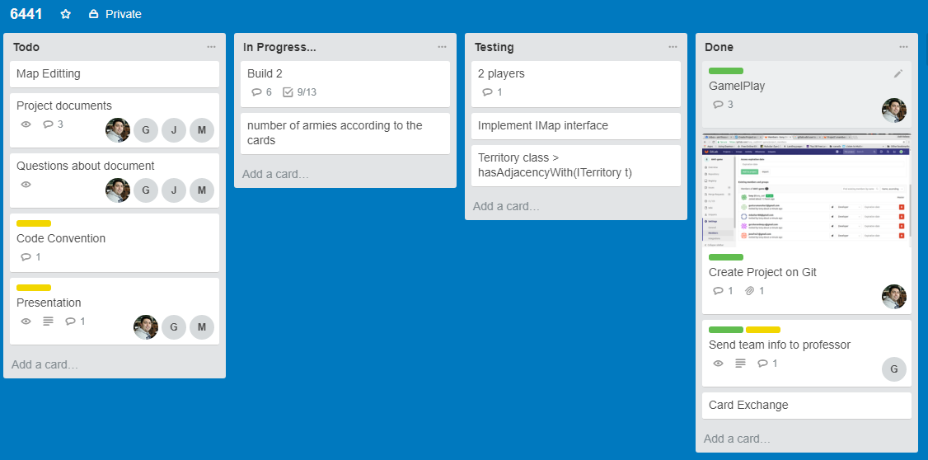
How we distributed the work

Slide 5
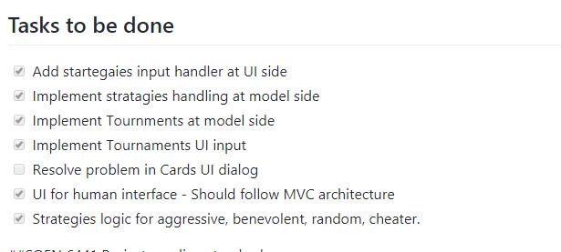
So finally we have used README file in GIT hub repository.
So who ever pick the task will tick it

Slide 6
How to make sure everyone follows coding standards
A team member whoever finds that code written by someone has no coding standards, then they update those mistakes in turtle sections.

Slide 7
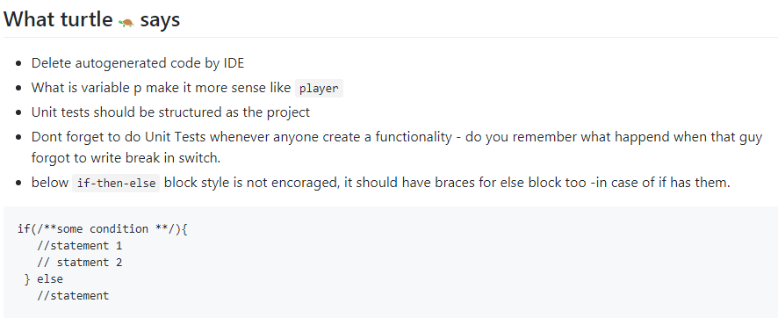
Turtle says we should make code better

Slide 8
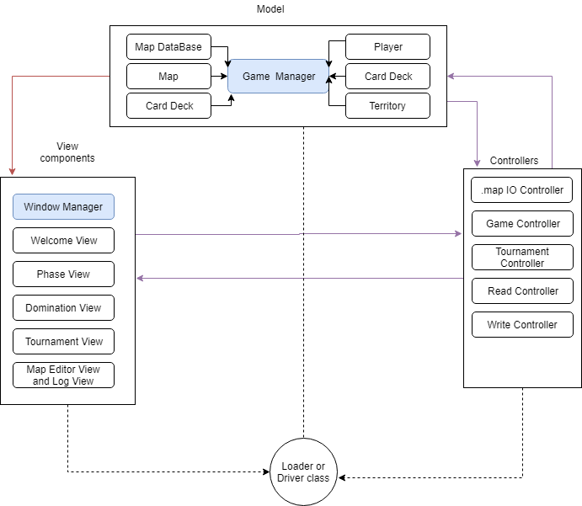
Architecture

Slide 9
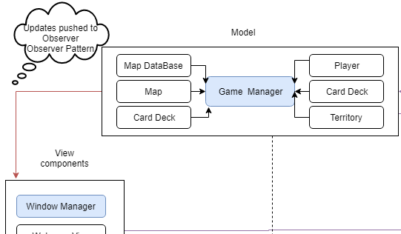
Model pushes the updates to views Example: Logging, Phase View and Domination View

Slide 10
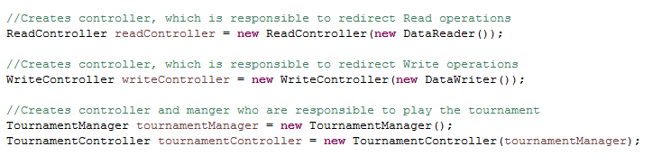
Driver class is responsible for dependency injection
Code snippet from driver class

Slide 11
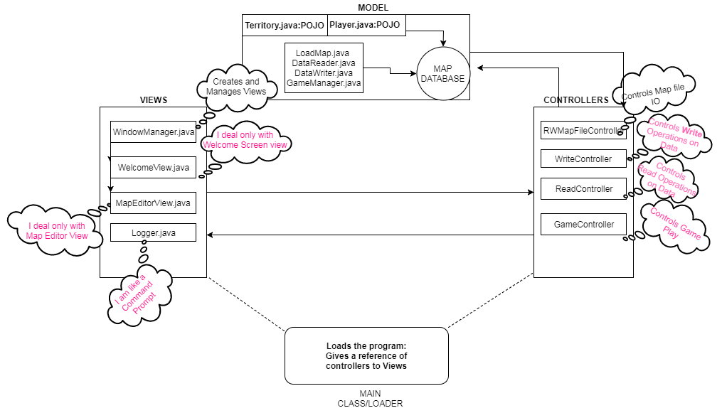
Architecture design diagram

Slide 12
Decoupled Architecture
We have ensured that view communicates with model only through the controller classes.
We have also split the controllers for MapIO operations, data read and write operations such that no controller depends on any other controller.
We have injected dependencies through constructor such that in feature integrations or development becomes easy.

Slide 13
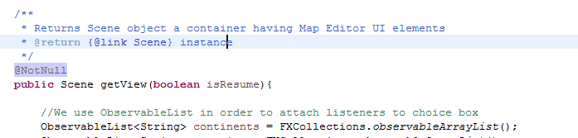
TO increase the readability of code
We tried to use annotations – which themselves says much about the a situation

Slide 14
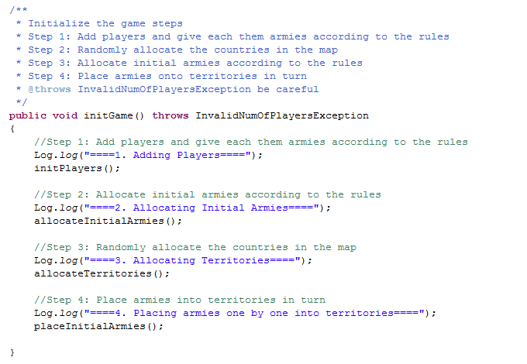
If a method has complex steps break them in steps

Slide 15
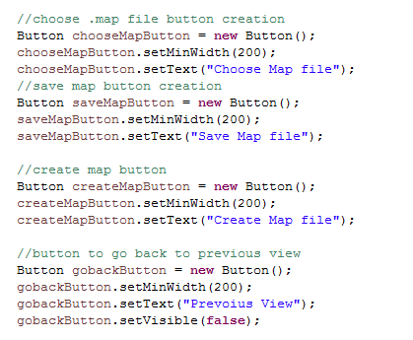
Inline comments can separate code by its purpose

Slide 16
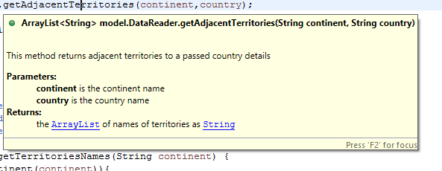
Its helps us for productivity, as there is no need to dig into destination method.

